Slide 1

Evaluation of teaching: the teaching portfolio and Peer Review
Tina Taylor, Vincent Wilding, Richard Swan – BYU Peer Review of Teaching Task Force
May 13, 2021
Notes:
Image credit: https://teaching.unsw.edu.au/what-is-formative-peer-review-of-teaching

Slide 2
problem
In the Rank and Status process,
  We have reasonably effective, quantitative measures for evaluating Scholarship
  However, there is not a comparable process for evaluating Teaching

Slide 3
background
Teaching is fuzzier to evaluate than scholarship
Student evaluations are the most broadly used measure of teaching effectiveness
  Valuable but imperfect measures
  Don’t measure everything
  Deterrent to trying innovative techniques
  Leads to a clear-the-bar attitude
Peer review may be an effective evaluation tool
  What does peer evaluation of teaching look like?
  Can it be effective without being overly time consuming?

Slide 4
charge
Propose an approach to evaluate teaching using peer review-
Built upon research-based principles and practices.
Fosters objective, reliable, and thorough reviews.
Provides developmental support for faculty.
Provides a consistent framework for peer reviewers to use across the University and a “tool kit” of approaches.

Slide 5
Opportunity - benefits
Provides substantive evaluation of teaching for R&S process
Encourages excellence in teaching
  Facilitates and encourages use of best teaching practices
  Encourages formative activities
Encourages and rewards innovation
Adds minimal work for faculty who are already deliberately striving to improve their teaching
Gives faculty more control of the narrative

Slide 6
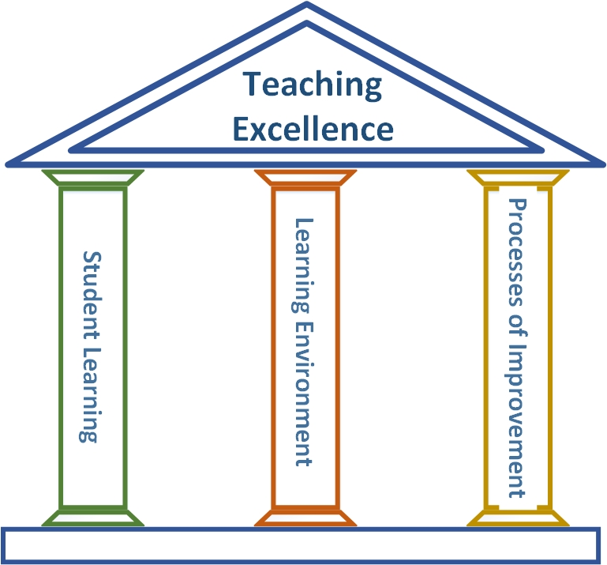
Three pillars of teaching excellence
Student Learning
Learning Environment
Processes of Improvement

Slide 7
Guiding Questions for Evaluating Teaching
1. Student Learning | 2. Learning Environment | 3. Processes of Improvement
a. Learning Outcomes Clear and appropriate? Reflect the Aims? Effectively communicated? | a. Relationships Integrate faith and inspire students? Instructor-student interactions? Student-student interactions? | a. Course Improvement Data used to improve learning environment and activities? Increased achievement of LOs?
b. Learning Activities Course well-organized? Activities well-designed and appropriate? Promote student engagement? Facilitate achievement of outcomes? | b. Settings Effective setting for inspiring learning? Atmosphere that motivates students to be engaged? Atmosphere of civility, respect, belonging? Learning accessible to all students? | b. Professional Development Engage in self-evaluation? Participate in activities to learn and develop as a teacher? Best practices implemented and impact assessed?
c. Learning Assessment Aligned with learning outcomes? Effective measures of learning? LOs being achieved? | c. Materials and other Resources Course materials appropriate? Used effectively to facilitate learning?
Notes:
Note that student evaluations provides valuable data about 1.b. and 2, but they do not give much about other aspects.

Slide 8
Process of teaching development
Before semester
  Development activities, such as Effective Teaching Workshop (CTL)
  Goals
  Learning outcomes/activities/assessments
During semester
  Personal notes
  Peer mentor observations and review
  Students Consulting on Teaching (SCOT)
End of semester
  Review of learning outcomes and student achievement
  Student ratings
  Self evaluation
Plans and adjustments for next offering

Slide 9
Faculty responsibility
Adopt a deliberate mentality about improving as a teacher.
Use Teaching Portfolio framework (Three Pillars).
Engage in efforts to assess and improve
    Invite formative feedback
      Formative peer review
      Student feedback (student surveys, SCOT)
    Critically evaluate learning data
    Set realistic improvement goals
Be consistent in the documentation process.

Slide 10
Teaching portfolio Process
Growing and current record of teaching
Formative activities documented
Facilitates self-evaluation
Facilitates continuous improvement
Basis for reviews
  Annual stewardship review
  R&S reviews

Slide 11
Constructing The Portfolio

Slide 12
The Teaching Portfolio is central to the evaluation process.
Self Evaluation
Annual Stewardship Interview
Teaching Portfolio
Rank & Status Review
Peer Review (summative)

Slide 13
What the faculty candidate does
Self Evaluation
+ Each semester/term
Teaching Portfolio

Slide 14
Self Evaluation
Teaching Portfolio
The Teaching Portfolio begins with self evaluation
  What good teachers already do; what all teachers should do—i.e., a best practice.
What is in your Teaching Portfolio?
  It is not a collection of all teaching artifacts
  It is a thoughtful compilation of evidence chronicling your growth as a teacher

Slide 15
Self Evaluation
Teaching Portfolio
Update your portfolio at the end of each semester/term using the Three Pillars :
Pillars | Example Sources of Evidence
Student Learning What went well? What could be improved? | Student performance on assessments Formative review by peers, others Student comments
Learning Environment What went well? What could be improved? | Mid-Course Evaluation Formative review by peers, SCOTs, others Student ratings & comments
Processes of Improvement What did I do to improve? What were the results? | Your plan based on type of improvement
Conclusion What is(are) the most important thing(s) to improve the next time I teach? | All of the above

Slide 16
What the faculty candidate does
Self Evaluation
+ Each semester/term
Annual Stewardship Interview
  Annual Summary
Teaching Portfolio

Slide 17
Annual Stewardship Interview
Teaching Portfolio
The Teaching Portfolio (for the year):
2-3 semester/term self-evaluations (done)
Annual Summary: Reflect on the past year, summarize and contextualize the results of teaching activities and your direction for continued growth.

Slide 18
What the faculty candidate does
Self Evaluation
+ Each semester/term
Annual Stewardship Interview
  Annual Summary
Teaching Portfolio
Rank & Status Review
  Teaching Narrative
Peer Review (summative)
  Teaching Narrative

Slide 19
Teaching Portfolio
Rank & Status Review
Peer Review (summative)
The Teaching Portfolio for Third Year and Sixth Year Review*
≈Two to five years of semester-end self-evaluations (d0ne)
Teaching Narrative: Reflect on the past years, summarize and contextualize the results of teaching activities and your direction for continued growth.
* Department adds peer reviews and student ratings & comments.

Slide 20
Faculty member
Self Evaluation
+ Each semester/term
Annual Stewardship Interview
  Annual Summary
Teaching Portfolio
Rank & Status Review
  Teaching Narrative
Peer Review (summative)
  Teaching Narrative

Slide 21
Reviewing the portfolio

Slide 22
Reviewers
Self Evaluation
Annual Stewardship Interview
  Student ratings & comments
Teaching Portfolio
Rank & Status Review
  Peer reviews
  Student ratings & comments
Peer Review (summative)
  Classroom observations
  Student ratings & comments

Slide 23
Peer reviewers’ responsibilities
Peer Reviewers rely primarily on the Teaching Portfolio and triangulate with classroom observations and student ratings & comments.
Rank and Status Review committees rely primarily on the Teaching Portfolio and triangulate with peer reviews and student ratings & comments.

Slide 24
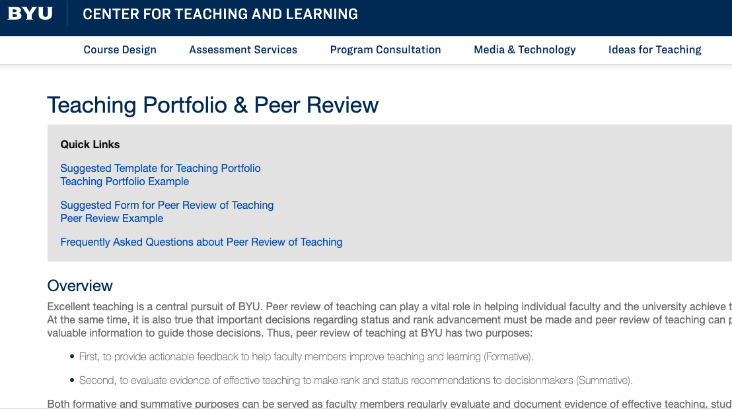
Resources
https://ctl.byu.edu/teaching-portfolio-peer-review

Slide 25

Notes:
Image credit: https://www.machinedesign.com/community/article/21836908/what-questions-should-you-ask-during-the-product-lifecycle

